Slide 1
Runge-Kutta Methods and Numerical Solution of Systems of Ordinary Differential Equations (ODE)
Dr. Luis Sanchez

Slide 2
Contenido:
Runge-Kutta Methods (RK).
Solving Systems of ODEs

Slide 3

Runge-Kutta Methods (RK)
Runge-Kutta methods achieve the accuracy of a Taylor series approach without requiring the calculation of higher derivatives.
$${ y}_{i+1}=y_{i}+φ(x_{i},y_{i},h)h \\ φ=a_{1}k_{1}+a_{2}k_{2}+⋯+a_{n}k_{n}$$
$$a′s=\text{constants}$$
$$k_{1}=f(x_{i},y_{i}) \\ k_{2}=f(x_{i}+p_{1}h,y_{i}+q_{11}k_{1}h) \\ k_{3}=f(x_{i}+p_{2}h,y_{i}+q_{21}k_{1}h+q_{22}k_{2}h) \\ ⋮ \\ k_{n}=f(x_{i}+p_{n−1}h,y_{i}+q_{n−1}k_{1}h+q_{n−1,2}k_{2}h+⋯+q_{n−1,n−1}k_{n−1}h)$$
Increment function
p’s and q’s are constants

Slide 4
k’s are recurrence functions. Because each k is a functional evaluation, this recurrence makes RK methods efficient for computer calculations.
Various types of RK methods can be devised by employing different number of terms in the increment function as specified by n.
First order RK method with n=1 is in fact Euler’s method.
Once n is chosen, values of a’s, p’s, and q’s are evaluated by setting general equation equal to terms in a Taylor series expansion.
n=2

Slide 5
Values of a₁, a₂, p₁, and q₁₁ are evaluated by setting the second order equation to Taylor series expansion to the second order term. Three equations to evaluate four unknowns constants are derived.

Slide 6
We replace k₁ and k₂ in to get
or
Compare with
and obtain (3 equations-4 unknowns)

Slide 7
Because we can choose an infinite number of values for a₂, there are an infinite number of second-order RK methods.
Every version would yield exactly the same results if the solution to ODE were quadratic, linear, or a constant.
However, they yield different results if the solution is more complicated (typically the case).
Three of the most commonly used methods are:
  Huen Method with a Single Corrector (a₂=1/2)
  The Midpoint Method (a₂=1)
  Raltson’s Method (a₂=2/3)

Slide 8
3rd Order Runge-Kutta
RK3

Slide 9
Classical Fourth-Order Runge-Kutta Method
The most popular RK methods are fourth-order, and the most commonly used form is:
where:

Slide 10
4th Order Runge-Kutta
RK4

Slide 11
Higher-Order Runge-Kutta
RK5

Slide 12

Exercise
Solving by hand a first-order ODE using the Four order Runge-­Kutta method.
Using h = 0.5.
Solution:
The first point of the solution is (0,3), which is the point where the initial condition is given. The values of x and y at the first point are x₁=0 and y₁=3.
The rest of the solution is done in steps. In each step the next value of the independent variable is calculated by:

Slide 13
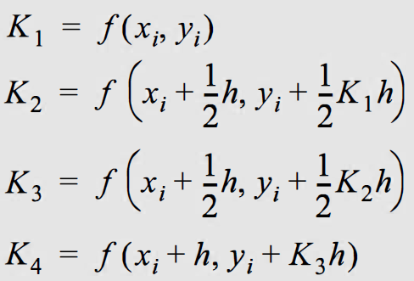
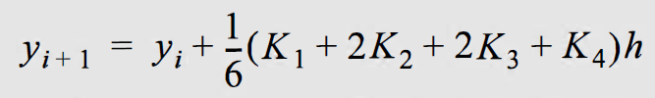
The value of the dependent variable Y_{i+1} is calculated by first evaluating K1, K2, K3 and K4 using:
And then substituting the Ks:
First step: In the first step i = 1

Slide 14
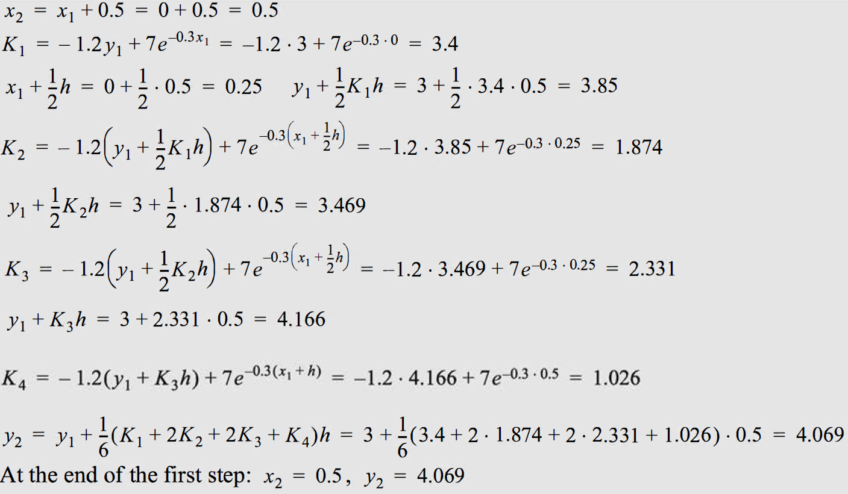
Second step: In the second step i = 2

Slide 15
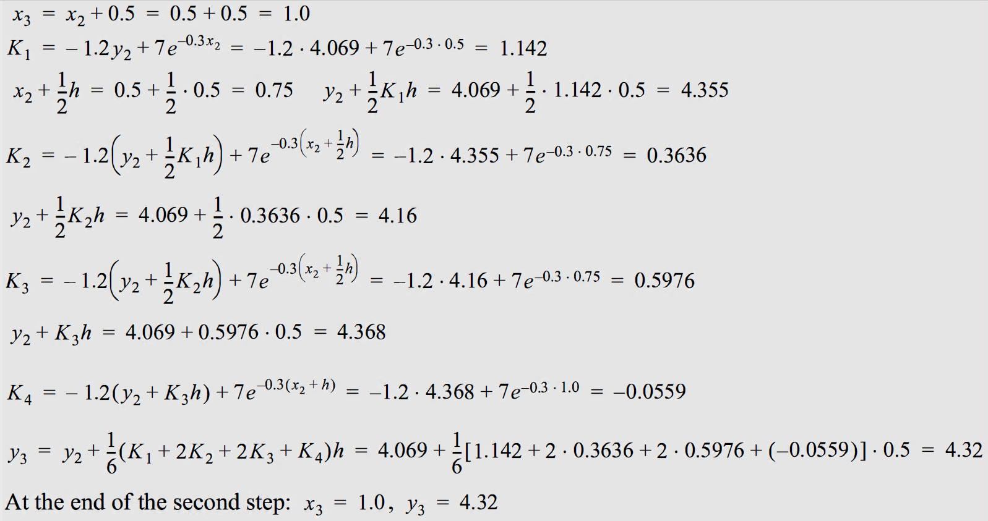
Third step: In the third step i = 3

Slide 16
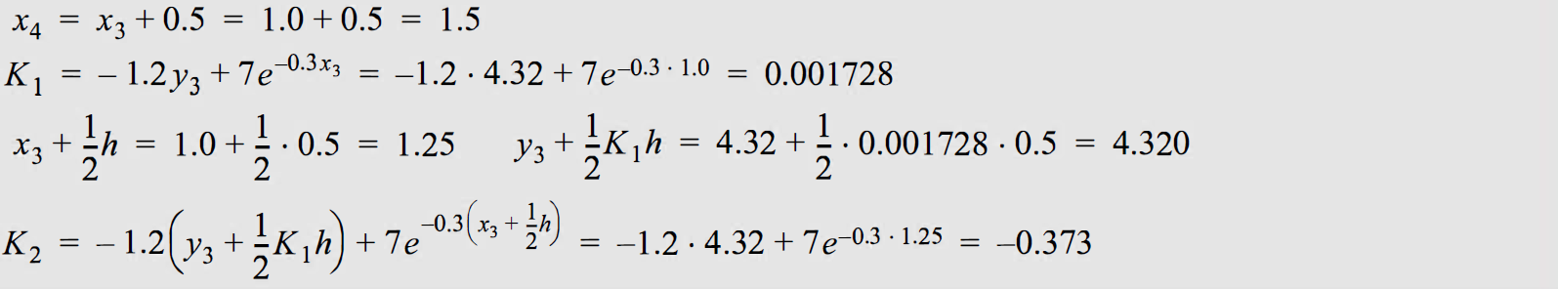
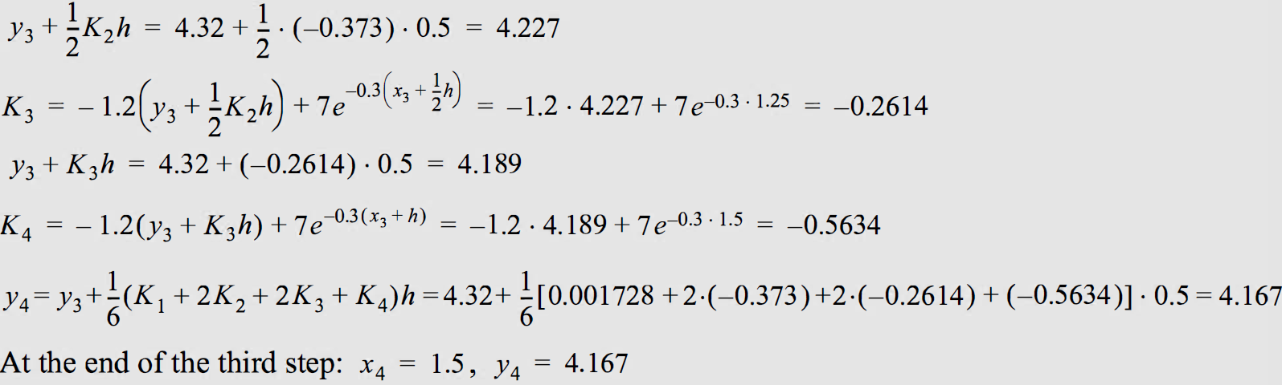
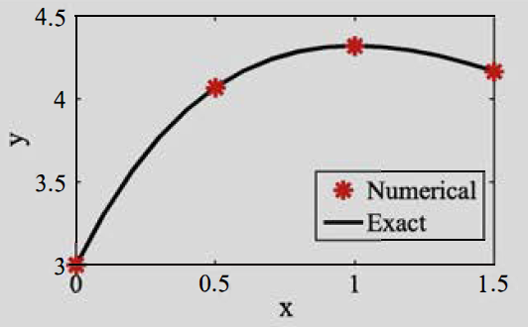
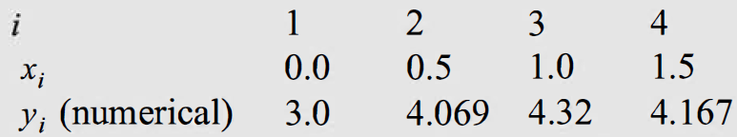

Slide 17

Exercise 01
Use all the third order Runge-­Kutta method to approximate the solutions IVP, and compare the results to the actual values.

Slide 18
Solving Systems of ODEs

Slide 19
Solving a System of First Order ODEs
Methods discussed earlier such as Euler, Runge-Kutta, are used to solve first order ordinary differential equations.
The same formulas will be used to solve a system of first order ODEs.
  In this case, the differential equation is a vector equation, and the dependent variable is a vector variable.

Slide 20
Euler Method for Solving a System of First Order ODEs
Recall Euler method for solving a first order ODE:

Slide 21
Example - Euler Method
Euler method to solve a system of n first order ODEs.

Slide 22
Solving a System of n First Order ODEs
The same formula is used but the scalar variables and functions are replaced by vector variables and vector values functions.
Y is a vector of length n.
F(Y,x) is a vector valued function.

Slide 23
Example :
Euler method for solving a system of first order ODEs.

Slide 24
Example :
RK2 method for solving a system of first order ODEs

Slide 25
Example :
RK2 method for solving a system of first order ODEs

Slide 26
Methods for Solving a System of First Order ODEs
We have extended Euler and RK2 methods to solve systems of first order ODEs.
Other methods used to solve first order ODE can be easily extended to solve systems of first order ODEs.

Slide 27
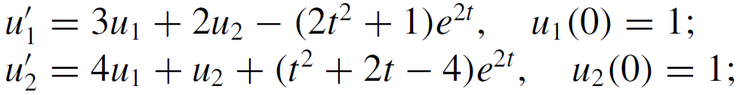

Exercise
Implement a Matlab Live Script to solve the following IVP, using Euler method:

Slide 28
Solucion analitica:
Compare the results to the actual solutions:

Slide 29
High Order ODEs
How do solve a second order ODE?
How do solve high order ODEs?

Slide 30
The General Approach to Solve ODEs
Convert
Solve
High order ODE
System of first order ODEs
Convert
Solve
Second order ODE
Two first order ODEs

Slide 31
Conversion Procedure
Convert
Solve
High order ODE
System of first order ODEs
Select the dependent variables
One way is to take the original dependent variable and its derivatives up to one degree less than the highest order derivative.
Write the Differential Equations in terms of the new variables. The equations come from the way the new variables are defined or from the original equation.
Express the equations in a matrix form.

Slide 32
Example of Converting a High Order ODE to First Order ODEs
One degree less than the highest order derivative

Slide 33
Example of Converting a High Order ODE to First Order ODEs

Slide 34
Example of Converting a High Order ODE to First Order ODEs
One degree less than the highest order derivative

Slide 35
Example of Converting a High Order ODE to First Order ODEs

Slide 36

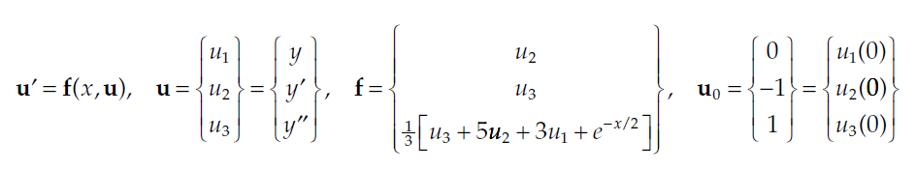

Exercise: Consider the third-order IVP
Using Euler’s method for systems, with step size h = 0.1, find an estimate for y2 = y(0.2).
Solution:

Slide 37
Conversion Procedure for Systems of High Order ODEs
Convert
Solve
System of high order ODEs
System of first order ODE
Select the dependent variables
Take the original dependent variables and their derivatives up to one degree less than the highest order derivative for each variable.
Write the Differential Equations in terms of the new variables. The equations come from the way the new variables are defined or from the original equation.
Express the equations in a matrix form.

Slide 38
Example of Converting a High Order ODE to First Order ODEs
One degree less than the highest order derivative
One degree less than the highest order derivative

Slide 39
Example of Converting a High Order ODE to First Order ODEs

Slide 40
Solution of a Second Order ODE
Solve the equation using Euler method. Use h=0.1

Slide 41
Solution of a Second Order ODE

Slide 42
Summary
Formulas used in solving a first order ODE are used to solve systems of first order ODEs.
  Instead of scalar variables and functions, we have vector variables and vector functions.
High order ODEs are converted to a set of first order ODEs.

